Slide 1
Edge Computing
Version: 2.0

Slide 2
Contents
Computing Evolution
Overview to Cloud Computing
Overview
Features
Service offerings models by clouds
Need for Edge Computing
Edge Computing and its relation with Cloud
Use cases of Edge Computing
Types of Edges
Edge Computing Platforms (Commercial/Open source)
Public clouds: AWS, Azure
Commercial: Siemens
Open Source: KubeEdge, EdgeGallery

Slide 3
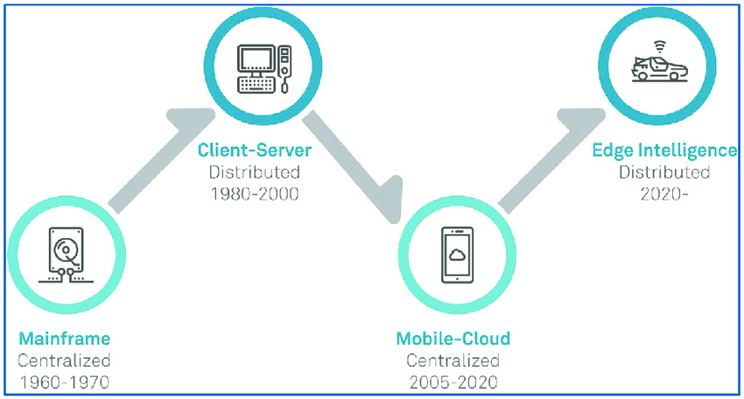
Computing Evolution
Mainframe(Centralized):
what: highly powerful and reliable computing machines, responsible for handling large data such as massive input-output operations.
Why: lack of internet and personal PC/servers, a centralized high computing machin used for computing by multiple users.
Client-Server(Distributed):
What: A client server architecture for data produced by clients and processed by remote servers over internet.
Why: Internet evolve and organization setup their data center to process user data in secure way, not in shared machine like mainframe.
Cloud Computing(Centralized):
What: centralized servers pools to do commuting, offered as service to organizations and public by providers
Why: client server has problem that each enterprise has to maintain infra/IT, with cloud it is reduced and offered flexibilities like pay as you go model.
Edge Computing(Distributed):
What: Compute, storage and networking resource are placed near to users.
Why: with evolving technologies like 5G, emerging use cases like auto driving and latency sensitive apps like AR/VR/MR, gaming etc. need computing near to data produce and meantime provide cloud level flexibilities like scaling, flexibility.
Cloud and Edge will co-exist and Edge computing is not replacement of cloud.

Slide 4
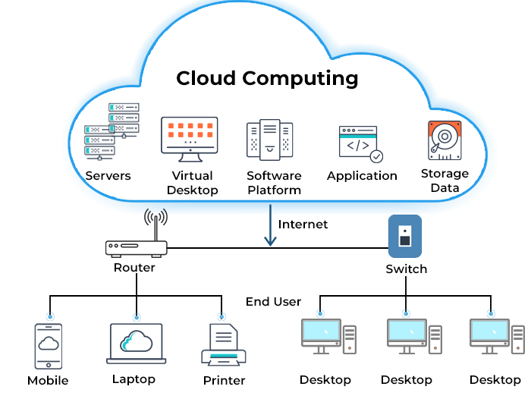
Cloud Computing Overview
Cloud computing is the delivery of computing services—including servers, storage, databases, networking, software, analytics, and intelligence—over the Internet (“the cloud”).
It offer faster innovation, flexible resources, and economies of scale.
Pay-as-you-go, helping lower operating costs, run infrastructure more efficiently and scale as business needs change.
Benefits of Cloud computing:
Cost: Reduce the Capex/Opex of buying hardware and software and setting up and running on-site datacenters.
Speed: Self service and on demand nature enable vast amounts of computing resources to be provisioned in minutes, typically with just a few mouse clicks.
Global scale: Scale elastically as per user demand across globe.
Performance: regularly upgraded to the latest generation of fast and efficient computing hardware.
Reliability: Makes data backup, disaster recovery and business continuity easier and less expensive because data can be mirrored at multiple redundant sites on the cloud provider’s network.
Security: Offer a broad set of policies, technologies and controls that strengthen security posture overall, helping protect your data, apps and infrastructure from potential threats.
Notes:
https://www.toolbox.com/tech/cloud/articles/what-is-cloud-computing/
https://data-flair.training/blogs/features-of-cloud-computing/
https://azure.microsoft.com/en-in/overview/what-is-cloud-computing/#benefits

Slide 5
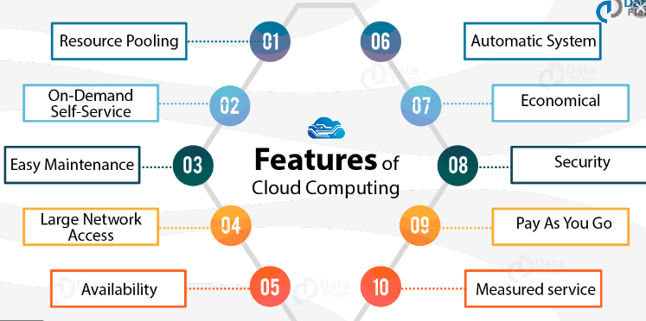
Features of Cloud Computing
Resource pooling: The provider's computing resources are pooled to serve multiple consumers using a multi-tenant model.
On-demand self-service: A consumer can unilaterally provision computing capabilities, such as server time and network storage, as needed automatically.
Easy Maintenance: Provider take care of infra with automatic latest version upgrade, security patch etc.
Large network access: Capabilities are available over the network and accessed through mobile phones, tablets, laptops, and workstations.
Availability: maintain redundant copy on different zones.
Automatic system: automatic provisioning, maintenance of large pools of servers.
Economical: enterprise no need to spend on Infra and IT.
Security: Offer a broad set of policies, technologies and controls that strengthen security posture overall, helping protect your data, apps and infrastructure from potential threats.
Rapid elasticity. Capabilities can be elastically provisioned and released
Measured service. Resource usage can be monitored, controlled, and reported,
Notes:
https://www.toolbox.com/tech/cloud/articles/what-is-cloud-computing/
https://data-flair.training/blogs/features-of-cloud-computing/
https://data-flair.training/blogs/features-of-cloud-computing/

Slide 6
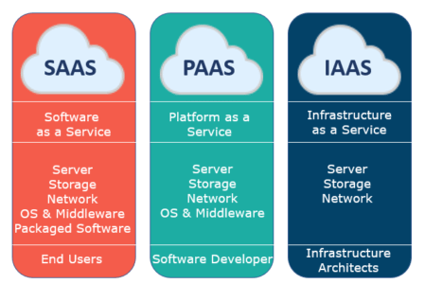
Service Models of Cloud Computing
Service model is how cloud provider offer cloud services. Some of the conventional service models of Cloud :
Infrastructure as a Service or IaaS: server, storage and network is provided by Cloud provider. User control and manage the operating systems, applications, middleware.
Platform as a Service or PaaS: cloud provider provides server, storage, network OS and middleware(development, deployment and LCM for user applications). User can run its applications there.
Software as a Service or SaaS: In SaaS, user have to purchase the ability to access or use an application or service, hosted by the cloud.
Office360, Google docs, Gmail
EdgeGallery, AWS Elastic Beanstalk, Google App engine
GCP(Compute Engine, Cloud storage, Disk, VPC)
Notes:
https://phoenixnap.com/blog/edge-computing-vs-cloud-computing

Slide 7
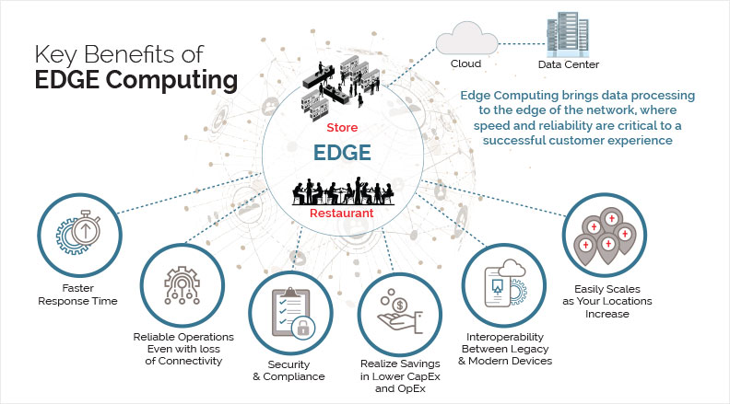
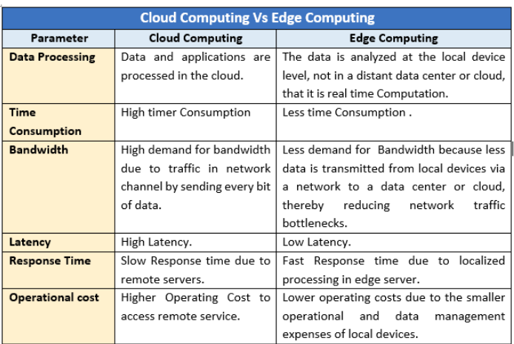
Need for Edge Computing
Some of the key requirement which need Edge computing:
Latency: latency sensitive applications/scenarios like auto driving, AR/VR/MR, remote surgery, Robot control in Factory etc. can not tolerate cloud latency.
Bandwidth: Huge data will be generated by IOT and Video contents over social media etc. all data carrying from end devices to cloud will put lot of bandwidth pressure on WAN Edge.
Reliable connection: for mission critical scenarios, controlling machine in factory, alert for sudden object in front of running car etc. can not afford unreliable connections. Edge Autonomy enable such cases.
Compliance. There are laws or policies in certain countries governing the regional transfer, store and process of data like GDPR rules.
Security. If you are going to send data all over the place, it will be vulnerable to attacks and breaches.
Interoperable legacy and modern devices. Legacy devices with proprietary/rare spec in factories could be easly plugin to Edges on Prem.
Notes:
https://www.hpe.com/us/en/newsroom/blog-post/2017/03/7-reasons-why-we-need-to-compute-at-the-edge.html
https://www.techtarget.com/searchdatacenter/definition/edge-computing
https://www.reliant.io/2018/12/05/edge-computing-reliant-and-the-evolution-of-it-infrastructures/
https://www.techtarget.com/searchdatacenter/definition/edge-computing

Slide 8
Edge platform characteristics comparison
Category | Cloud | Edge
Resource capacity | Very High | constraint/limited
Number of services | Most of services available | LImited, specific to Edge applications
Deployment type | Centralized | Distributed
Network Policy | Flexible | Stricte - behind firewall
locations | central | Near to user
Platform management | Central(On cloud) | central(Cloud/data center)
Application Orchestration | Central(On cloud) | central(Cloud/data center)
Application LCM | Central(On cloud) | On Edge
Network services | No | Yes(in case of telco edge)
??

Slide 9
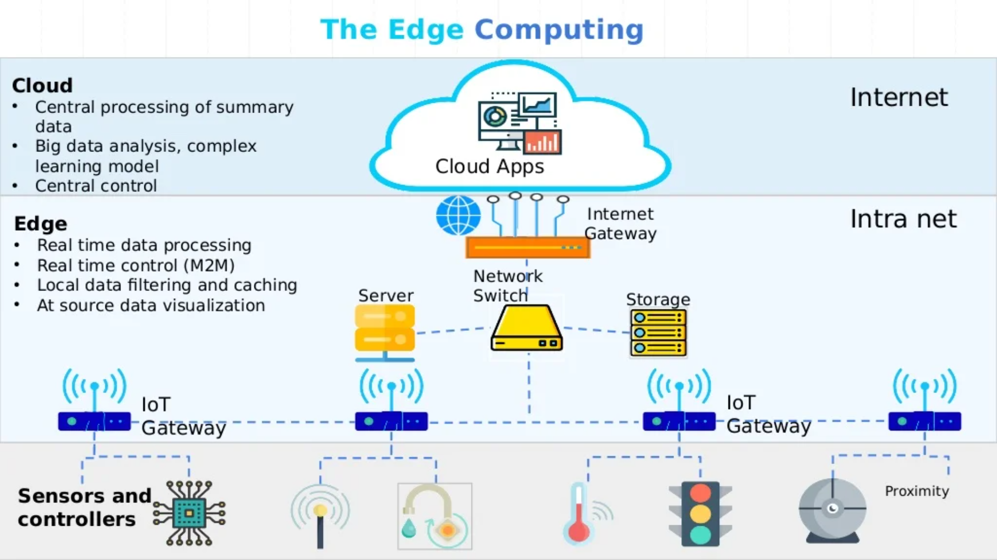
Edge computing and Its relations with Cloud
Edge computing is the deployment of computing and storage resources at the nearest location where data is produced. It is a distributed architecture.
Rather than transmitting raw data to a central data center, data processing/storage is performed where data is generated like a retail store, a factory floor, across a smart city.
Only the result of that computing work at the edge, such as real-time business insights, equipment maintenance predictions etc. is sent back to the main data center further deep analysis, storage etc..
Faster networking technologies, such as 5G wireless, are allowing for edge computing systems to accelerate the creation or support of real-time applications, such as video processing and analytics, self-driving cars, artificial intelligence and robotics, to name a few.

Slide 10
Edge computing Use cases
Here are few Edge computing use cases:
Autonomous vehicles.
Industrial automation.
Augmented reality (AR) and virtual reality (VR)
Retail.
Connected homes and offices.
Predictive maintenance.
Video monitoring.
Software-defined networking.
Notes:
https://www.xenonstack.com/blog/edge-computing/

Slide 11
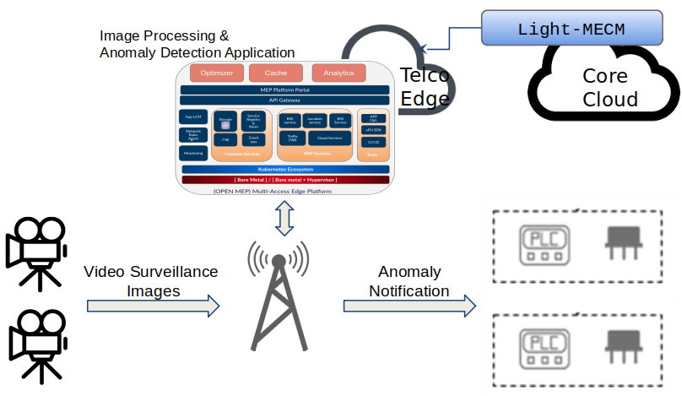
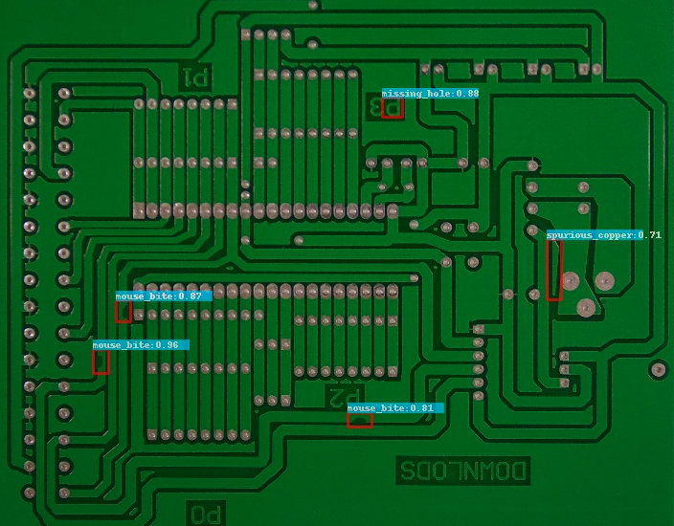
PCB Defect detection use cases(Industrial Rev. 4.0 - factory Automation)
Why PCB Defect detection:
Testing printed circuit boards (PCBs) throughout the design and manufacturing processes is essential in ensuring quality products. Even after following proper design and manufacturing processes, there is always a risk of defects, bugs, human errors at the prototype stages. Identifying and addressing these issues before the final product is critical in ensuring the performance, functionality, and reliability of the products.
A wide range of defects in PCBs may arise due to human error, a wrong manufacturing process, poor design, and other practices.
PCB Defect detection Benefits:
- Identifying and addressing faults and bugs such as short circuits, opens, poor/weak soldering, cleanliness etc.
- It provides an opportunity to address any potential issues early before going into final production, saving time and money. Fixing the problems on finished products is usually more difficult, time-consuming and costly
- Reducing wastage and costs since the testers use the small-scale assemblies and prototypes instead of complete products. This prevents throwing away faulty, full-scale assemblies.

Slide 12
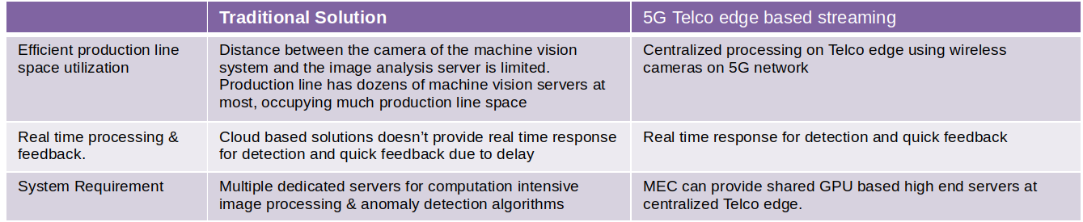
PCB Defect detection use cases - Why Edge
Use case has Low latency requirement asking for limited distance between camera of the machine vision system and the image analytics systems. Local solution in enterprise involves dozens of machine vision servers occupies log of production line space. This is where 5G Telco edge for Machine vision could play a role.

Slide 13
AR use case
What is AR/VR: Augmented reality allows users to have additional information from their environment by performing an analysis of their surroundings, deriving the semantics of the scene, augment it with additional knowledge provided by databases, and feed it back to the user within a very short time. The device can be for example a smartphone or any wearable device with a camera and other sensors.
Why Edge computing: AR applications like rendering, can run on Edge computing platform which offload computation from devices and reduce latency
Request Flow:
In response to a request from the user, the UE needs to be connected to an instance of a specific application, running on an appropriate MEC host fulfilling the latency requirements of the application.
A new instance of the application needs to be started if it is not yet running.
The application might have a set of requirements (e.g. latency, compute resources, storage resources, etc.) that needs to be fulfilled by the host.
The MEC system needs to select a MEC host that fulfils all the requirements.
Notes:
https://www.etsi.org/deliver/etsi_gs/mec/001_099/002/02.01.01_60/gs_mec002v020101p.pdf

Slide 14
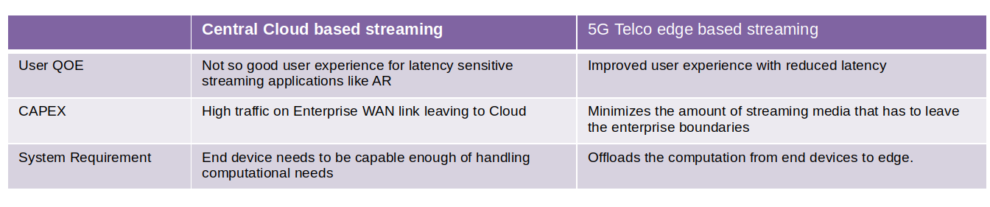
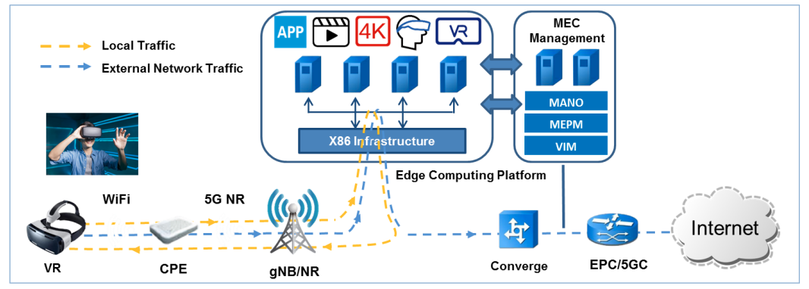
AR use case - Edge computing Benefits

Slide 15
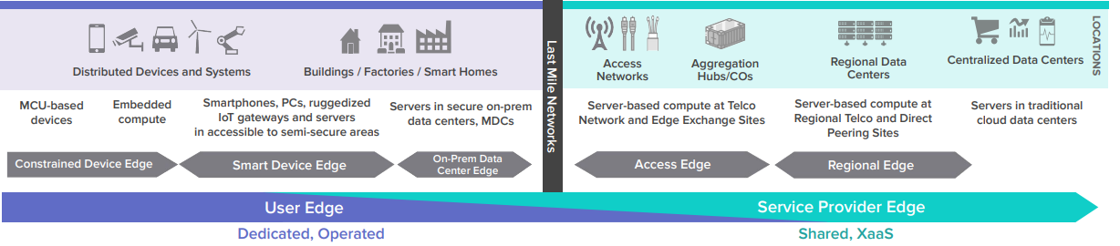
Different types of Edges
Edge computing can be divided in broad level in below category based on placement and type use cases.
( Dedicated/shared, Location/Latency, )
Telco pestective:
User Edge:
Far Edge(Device/Smart device Edge) - near to user like IOT-Gateway, uCPE(use cases Industrial IOT, smart Homes, smart Cities etc.)
On Prem Edge - Industrial Edge with On Prem computing
Service provider Edge:
On Prem Edge(Provided by service provider) - Industrial Edge with On Prem computing
Telco Edge(Access/Regional Edge): provided by Telco over network edges(MEC - Multi Access Edge)
Notes:
https://www.xenonstack.com/blog/edge-computing/

Slide 16
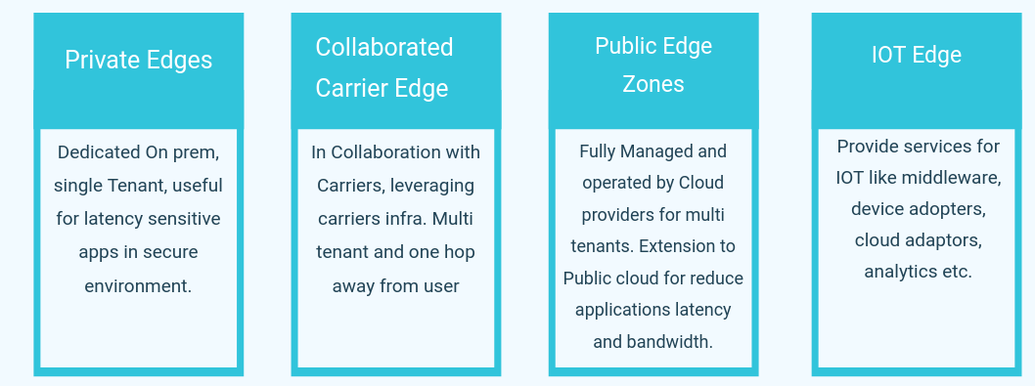
Different types of Edges - Cloud Perspective
Public cloud Edge:
Public clouds offer edge solutions as on prem to customer, public edges, in collaboration with Telco and IOT Edges.
Cloud see edges as extension of their cloud and they offer seamless experience to users.
Increase latency
Notes:
https://www.xenonstack.com/blog/edge-computing/

Slide 17
Edge Computing Platforms
Cloud Providers:
AWS:
Outpost - Private On Prem Edge
Local zones - Public edge
Wavelength - In collaboration with Carriers,
IOT Edge (GreenGrass)
Azure:
Private Edge zones - Private On Prem Edge
edge zones - Public edge
Edge Zones with carriers
IOT Edge(IOT Edge stack and IOT Hub)
Vendors:
Siemens: Edge Platforms for Industrial IOT
Open source:
EdgeGallery: MEC based Telco Edge
KubeEdge: Cloud Public Edge
Smart Edge + EMCO: Telco Edge

Slide 18
AWS and Azure Edge Offerings details

Slide 19
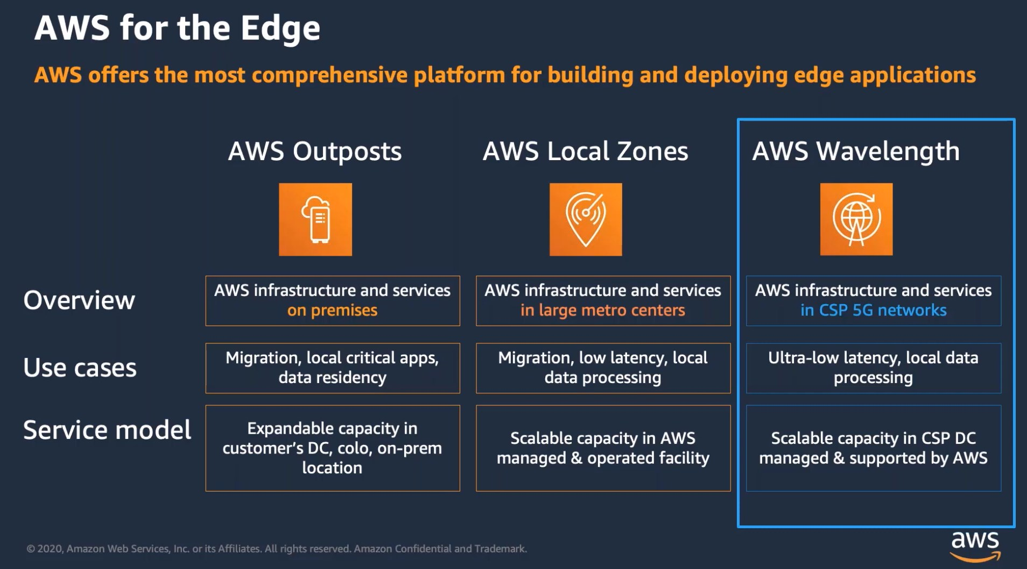
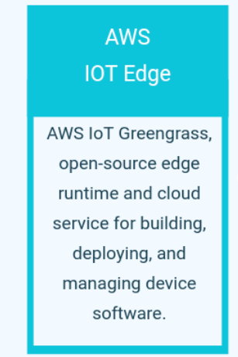
Public Cloud Edges - AWS offerings
Notes:
https://www.itworldcanada.com/article/bell-announces-the-first-aws-wavelength-zone-in-canada/481732

Slide 20
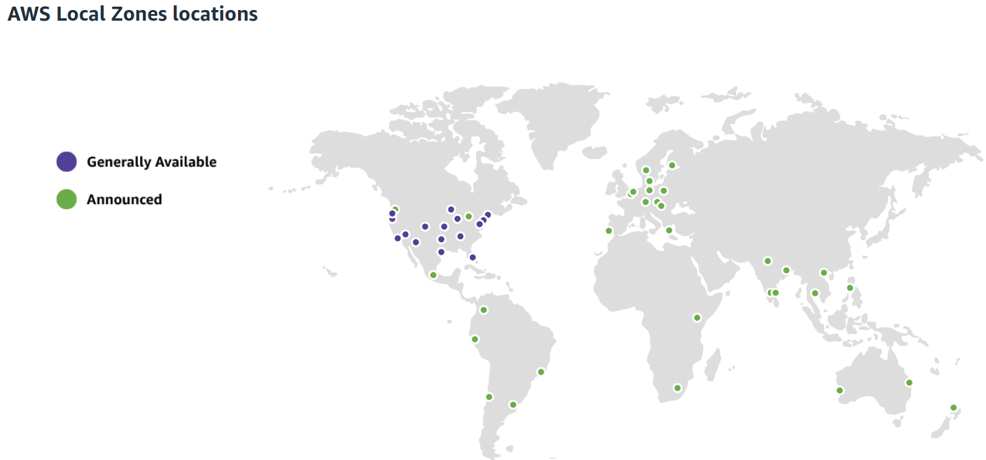
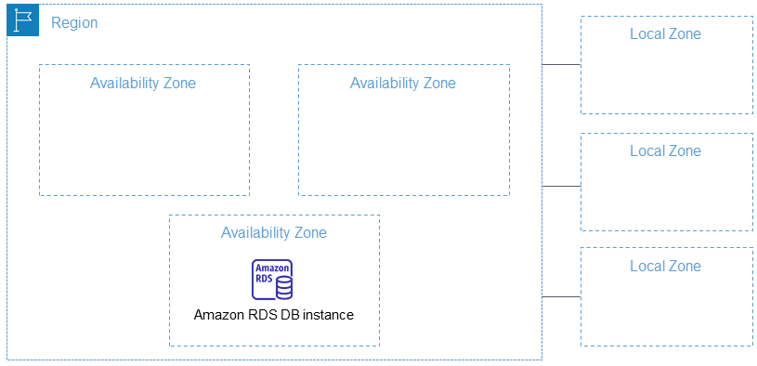
AWS Local Zones
Extension to Public cloud, placed compute, storage, database, and other select aws services close to large population and industry centers for enable Latency sensitive applications
AWS services:
Infrastructure Services: Amazon EC2, Amazon EBS, Amazon FSx, Amazon Elastic Load Balancing and Amazon VPC
Database – Amazon Relational Database (RDS) instances
Containers – Amazon Elastic Container Service (ECS) and Amazon Elastic Container Service for Kubernetes (EKS) clusters
Data processing – Amazon Elastic Map Reduce (EMR) nodes
AWS Local Zones provide a high-bandwidth, secure connection between local workloads and those running in the AWS Region, allowing you to seamlessly connect to the full range of in-region services through the same APIs and toolsets.
For example, https://dynamodb.us-west-2.amazonaws.com is the endpoint for the Amazon DynamoDB service in the US West
Example Apps: Low-Latency sensitive Gaming applications (Region, Local Zones)

Slide 21
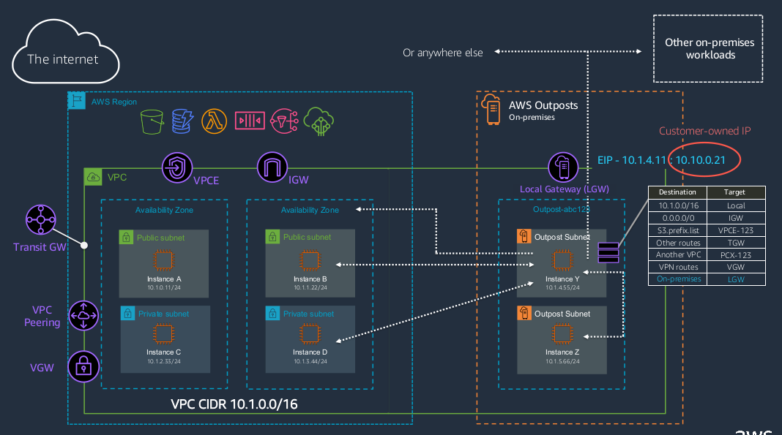
AWS OutPost
Private Edge, Dedicated, single tenant, serever/hardware provided by AWS. secure, regulation, latency sensitive applications
Customers can extend their regional Amazon VPC to AWS Outposts by creating a subnet and associating it with AWS Outposts
LGW is a local interconnect virtual router customers can use to connect their AWS Outposts subnets with their local on-premises networks for low latency access to on premises resources
AWS services:
Infrastructure Services: Amazon EC2, Amazon EBS, and Amazon VPC
Database – Amazon Relational Database (RDS) instances, Amazon Elasticache
Containers – Amazon Elastic Container Service (ECS) and Amazon Elastic Container Service for Kubernetes (EKS) clusters
Data processing – Amazon Elastic Map Reduce (EMR) nodes
Local storage - Amazon S3
use the same AWS APIs, tools, and infrastructure across on-premises and the AWS cloud to deliver a truly consistent hybrid experience
Example Apps: Dedicated, Industrial Edge Applications (Outpost)
Notes:
https://blog.56k.cloud/whats-the-differences-aws-outpost-wavelength-snowball/

Slide 22
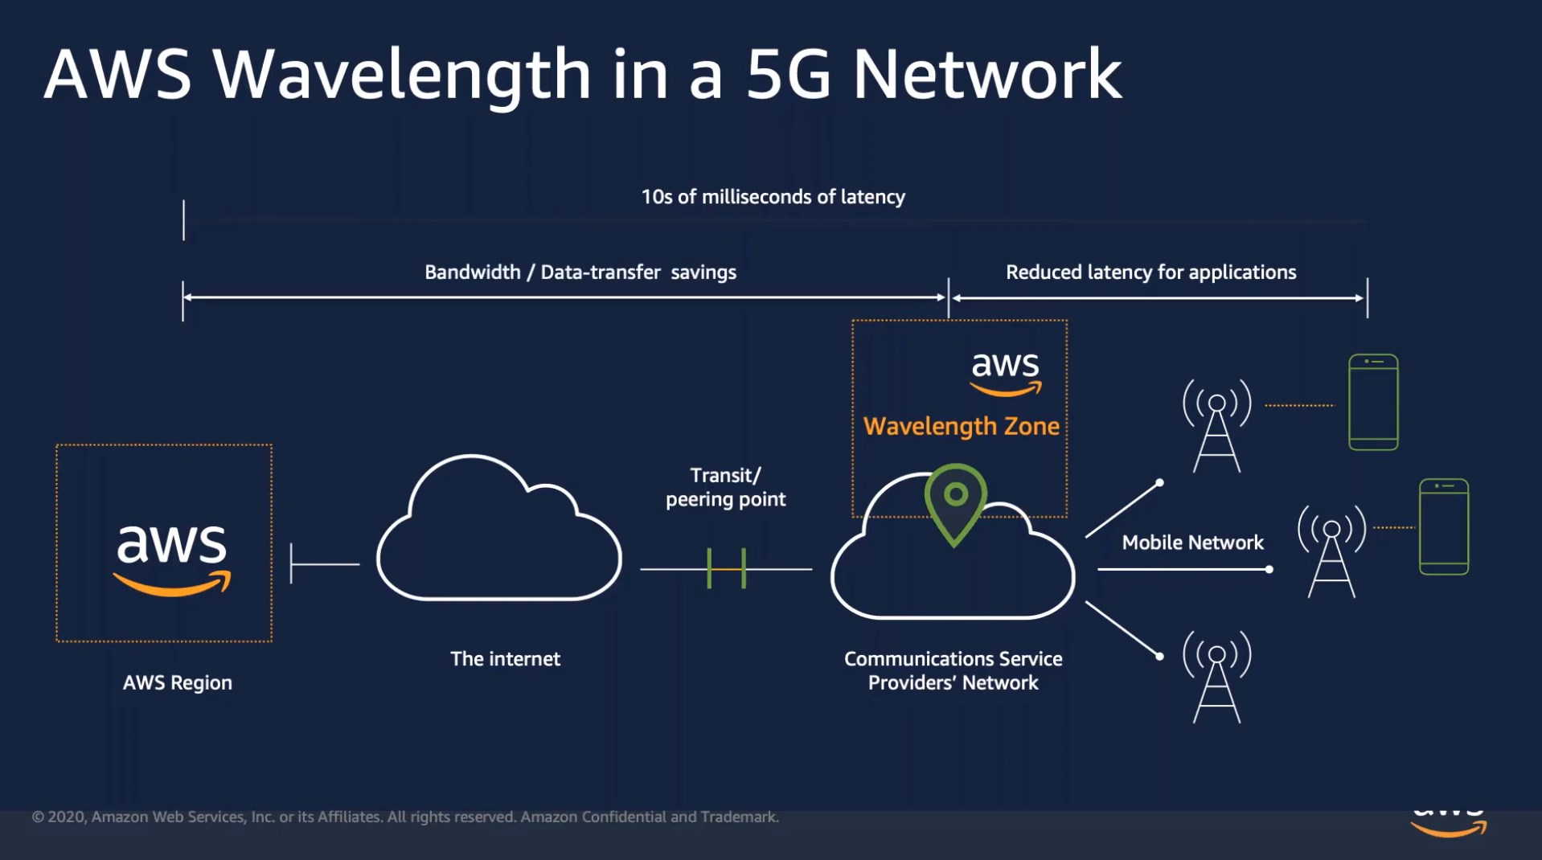
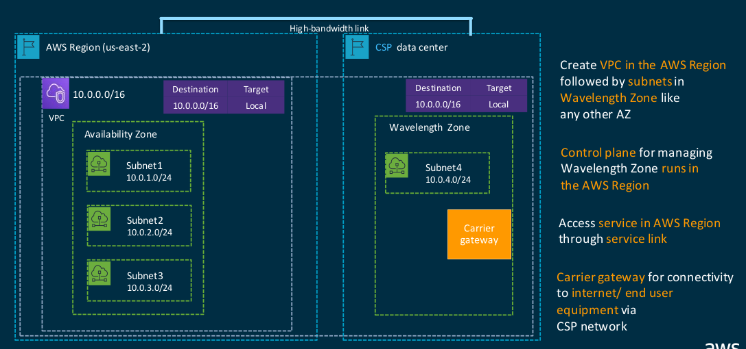
AWS Wavelength
In Collaboration with carrier, AWS place resources and provide services from carrier locations like base stations.
AWS services:
Compute - Amazon EC2
Networking- Amazon VPC, Carrier gateway
Storage – Amazon EBS
Containers – Amazon Elastic Container Service (ECS) and Amazon Elastic Container Service for Kubernetes (EKS) clusters
Wavelength Zones allow developers to build applications that deliver ultra-low latencies to 5G devices and end users
Bell Canada announces the first AWS Wavelength Zone in Canada
Example Apps: Distributed Edge Applications Built on 5G

Slide 23
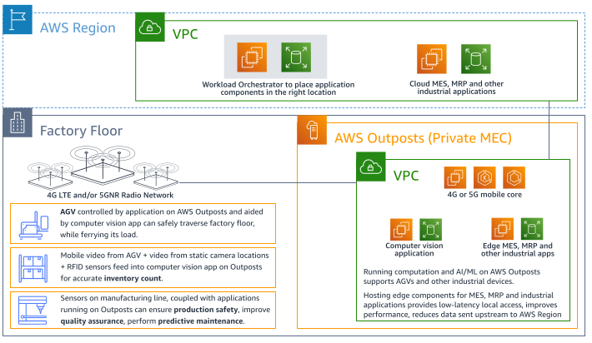
PRIVATE MEC SOLUTION FOR FACTORY FLOOR APPLICATIONS based OutPost

Slide 24
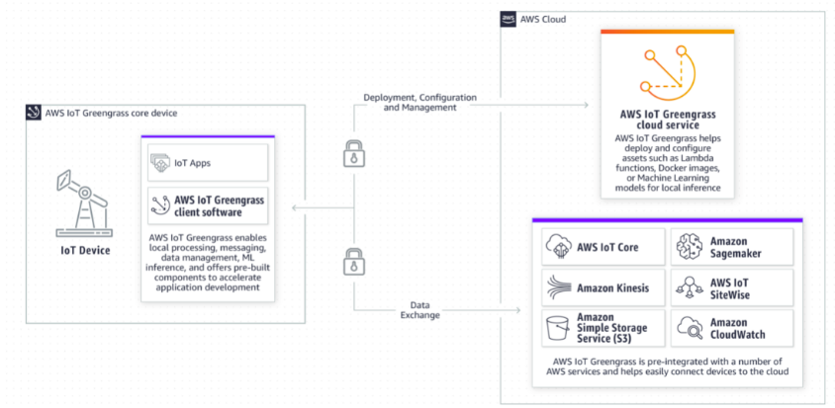
Public Cloud Edges - AWS IOT
Features:
Local processing
Local processing for AWS Lambda
Local support for AWS IoT Device Shadows - The Device Shadow caches the state of your device, like a virtual version or “shadow,” of each device that tracks the device’s current versus desired state and synchronizes that state with the cloud when connectivity is available.
AWS IoT Greengrass ML Inference
Stream Manager for AWS IoT Greengrass
Stream analytics
AWS IoT Greengrass is an open-source edge runtime and cloud service for building, deploying, and managing device software.

Slide 25
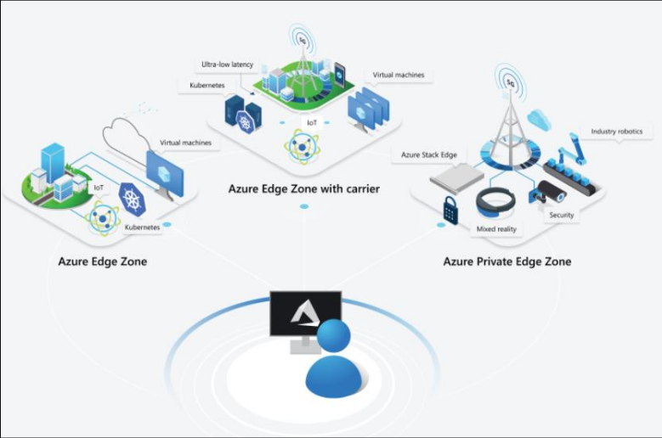
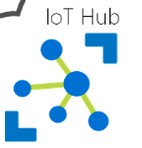
Public Cloud Edges - Azure offerings
Azure Edge Zones
Azure Edge Zones with carrier
Azure private Edge Zones
Azure IOT Edge
Azure IOT EDge

Slide 26
Azure Edge Zones
Azure Edge Zones are micro data centers that are owned and operated by Microsoft.
Act as logical extensions of existing regions that are a part of the Microsoft global network.
Azure Edge Zones support VMs, containers, and a subset of Azure managed services that can run latency-sensitive and throughput-intensive applications that live close to end-users.
Supports multi-tenant.
Notes:
https://www.forbes.com/sites/janakirammsv/2020/04/03/microsoft-unveils-a-comprehensive-edge-computing-strategy-with-azure-edge-zones/?sh=30aa7ad0234b

Slide 27
Azure Edge Zones with carrier
Azure Edge Zone running within the 5G infrastructure of a telecom provider instead of Microsoft’s global infrastructure.
Azure Edge Zones with Carrier infrastructure are placed one hop away from the mobile operator's 5G network, offering sub-10 millisecond latency to applications from mobile devices.
These Edge Zones are connected to the Azure public cloud via Microsoft’s global network.
Organizations and businesses that use the same 5G network will gain high-speed connectivity to the Azure Edge Zone.
Supports multi-tenant.
Microsoft partnered with AT&T to offer Azure Edge Zones with Carrier in a number of locations, including Atlanta, Dallas, and Los Angeles.
Notes:
https://www.forbes.com/sites/janakirammsv/2020/04/03/microsoft-unveils-a-comprehensive-edge-computing-strategy-with-azure-edge-zones/?sh=30aa7ad0234b

Slide 28
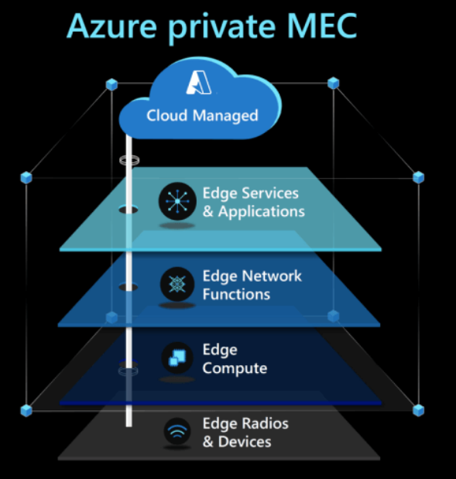
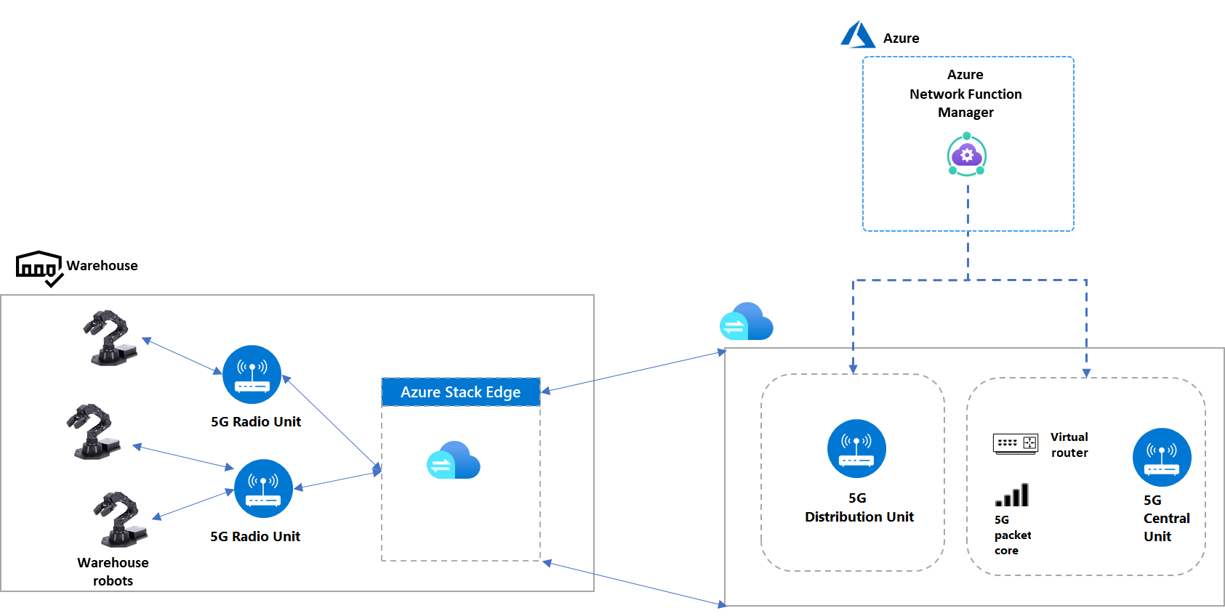
Azure private Edge Zones
The 5G Standalone network is deployed as a Non-Public Network (NPN), with all data remaining on premises. The NPN configuration offers security, privacy, and reliability. Azure deploys and manages the network and devices.
Embedded 5G-enabled IP modules connect warehouse robots to 5G Open Radio Access Network (ORAN) radio units.
The 5G radio units connect over a wired switching network to the 5G distribution unit software, which runs on private MEC on Azure Stack Edge.
The 5G distribution unit connects with the virtual router, 5G central unit, and 5G packet core, which run on a separate Azure private MEC instance on Azure Stack Edge.
The 5G packet core provides device authentication, an IP address, and connectivity based on a preconfigured profile.
Azure Network Function Manager controls both MEC instances.
Optimizing the 5G network and keeping traffic confined to Azure private MEC provides the low latency these connection scenarios require.
Supports single tenant
Microsoft working with AT&T and their mutual customers in the automotive space to improve their factory operations, travel and logistics customers to make asset-tracking more accurate and cost-effective, and experimenting with opportunities to improve worker safety in heavy manufacturing scenarios through live video analytics.
Notes:
https://docs.microsoft.com/en-in/azure/architecture/solution-ideas/articles/low-latency-network

Slide 29
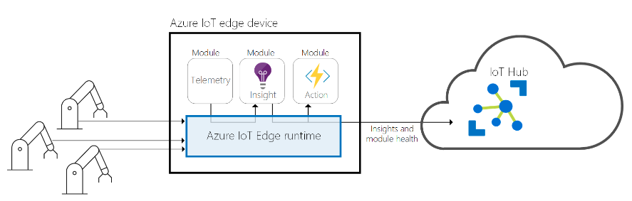
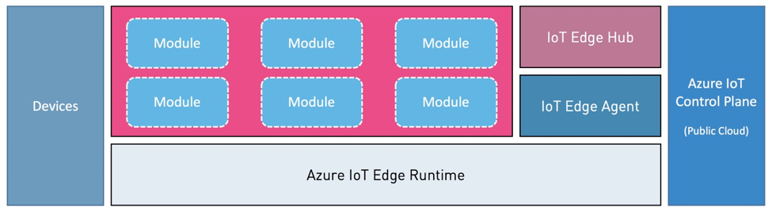
Azure IoT Edge
IoT Edge Runtime(open source): The runtime sits on the IoT Edge device, and performs management and communication operations. The runtime performs several functions:
Installs and update workloads on the device.
Maintains Azure IoT Edge security standards on the device.
Ensures that IoT Edge modules are always running.
Reports module health to the cloud for remote monitoring.
Manages communication between downstream leaf devices and an IoT Edge device, between modules on an IoT Edge device, and between an IoT Edge device and the cloud.
Modules: Docker-compatible containers from Azure services or Microsoft partners to run your business logic at the edge.
Cloud interface: Remotely manage and deploy workloads from the cloud through Azure IoT Hub with zero-touch device provisioning
IoT Edge hub can determine whether it's connected to IoT Hub. If the connection is lost, IoT Edge hub saves messages or twin updates locally. Once a connection is reestablished, it syncs all the data.
Notes:
https://azure.microsoft.com/en-in/services/iot-edge/#iotedge-features
https://github.com/Azure/azure-iot-protocol-gateway/blob/master/README.md

Slide 30
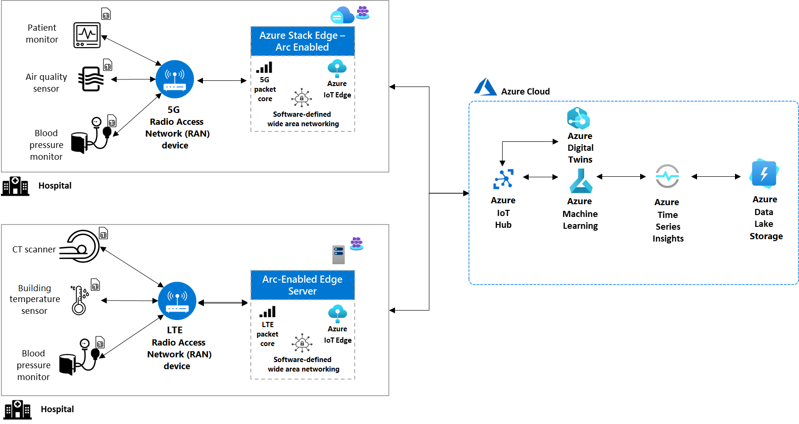
Azure IOT Use Case: IoT device connectivity for healthcare facilities
Hospital buildings use various connected devices to monitor both patient health and facility performance.
Health-tracking devices include patient monitors, CT scanners, and blood pressure monitors.
Building safety and quality devices include air quality and building temperature sensors.
The patient health and building monitoring devices send data to LTE or 5G RAN devices.
The 5G or LTE radios in the hospitals forward the data to the 5G or LTE packet cores running on the edge servers. The edge servers can be Azure Stack Edge or any Azure Arc-enabled servers.
On the edge servers, the IoT Edge runtime can preprocess data before sending it to Azure for further analysis.
In the cloud, Azure IoT Hub ingests data quickly and securely, and sends it to Azure Machine Learning.
Azure Machine Learning incorporates the new data to further optimize the model that controls the smart building settings.
Data from Azure IoT Hub also feeds into Azure Digital Twins, which provides a map of the hospitals' networked IoT devices as a virtual simulation.
Data also feeds into Azure Time Series Insights, which can analyze patient health over a period of time, or treatment efficacy over several hospitals. Time Series Insights also offers a visualization layer to aid in decision-making.
All the data is stored in Azure Data Lake Storage, which can store data of any format and size.
Notes:
https://docs.microsoft.com/en-in/azure/architecture/solution-ideas/articles/healthcare-network

Slide 31
Siemens: Edge computing platform

Slide 32
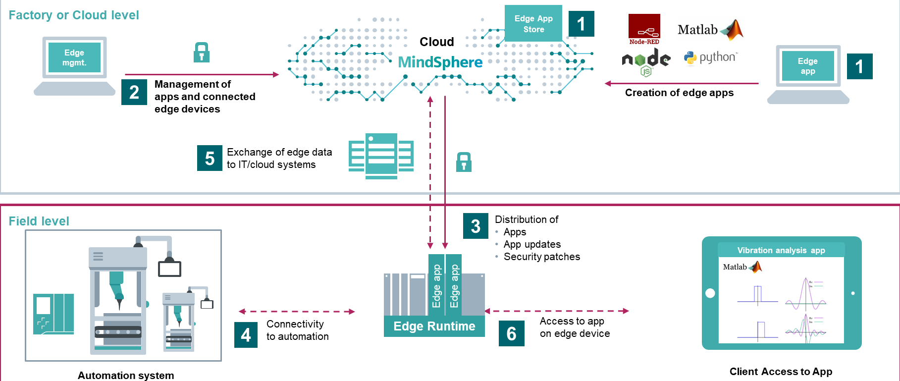
Siemens Edge platform(On-Prem Industrial IOT Edge)
Industrial Edge for Machine Tools
Machine Tool domain to host applications from different vendors on a computing platform close to the shopfloor.
Enables the extensions of automation, deployment of demanding stream processing and learning algorithms as well as the hosting from integration code to site automation.
Key Features:
App Dev and store
Edge Device management: secure onboarding and software update of edge devices
Application Management for deployment, configuration and lifecycle management
connectivity for MindSphere IoT
Easy configuration of IoT Model
Usage of visual analyzer, fleet manager and notification services
User management and reverse proxy
Notes:
https://documentation.mindsphere.io/resources/html/manage-my-sinumerik-edge-app-management/en-US/user-docu/industrialedge.html

Slide 33
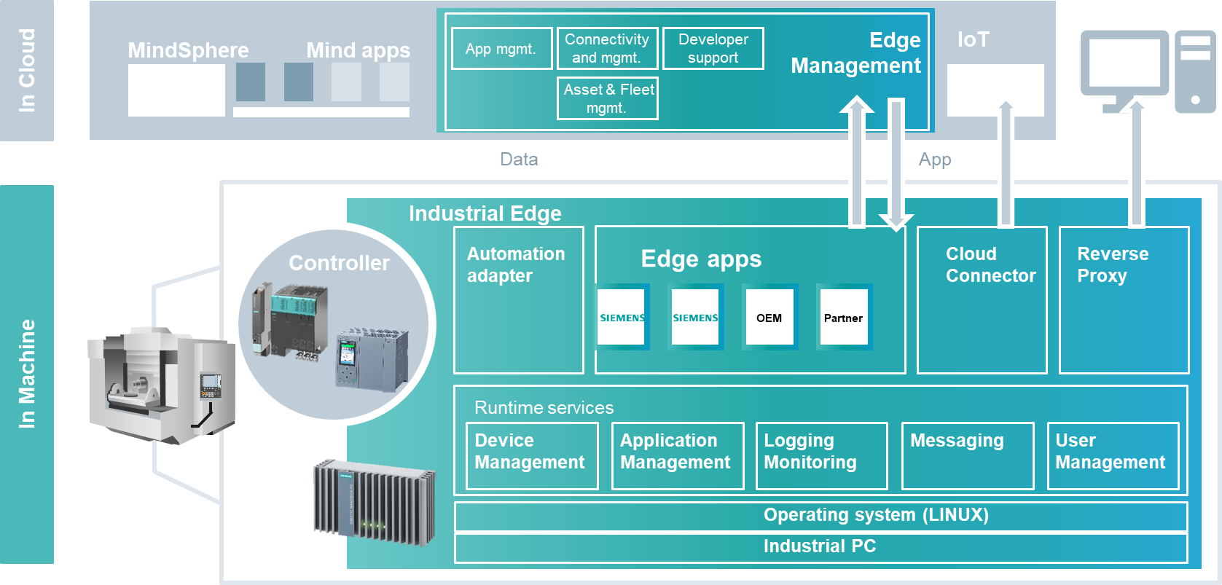
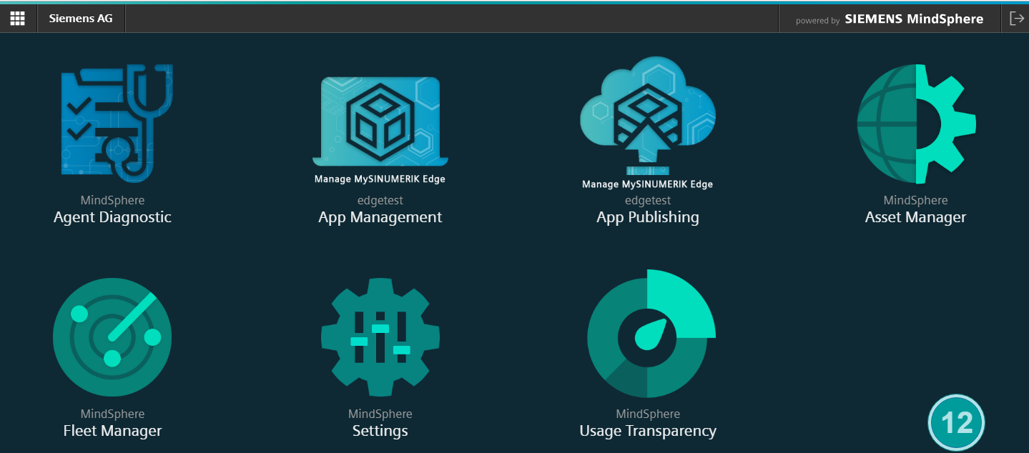
Architecture
Industrial Edge Runtime:
Device Management: Onboarding, network configuration and power cut safe software update over the air
Application Management - deploy, configure, remove, start, stop, reset
Logging and Monitoring : supervision of Edges and Applications from backend side
messaging system: data integration from apps.
user management
The Automation adapter
The cloud connector to connect to cloud
MindSphere Backend - Industrial Edge Services:
App Management for choosing and lifecycle management of apps
App Publishing to the global App repository
Secured industrial grade connectivity
Asset and fleet management including visual analyzer and notification services
Hosting and operation from own MindApps
Consumption from 3rd party MindApps
Notes:
https://documentation.mindsphere.io/resources/html/manage-my-sinumerik-edge-app-management/en-US/user-docu/dataprovisioningtoms.html
https://documentation.mindsphere.io/resources/html/manage-my-sinumerik-edge-app-management/en-US/user-docu/industrialedge.html

Slide 34
Open Source Edge Platforms

Slide 35
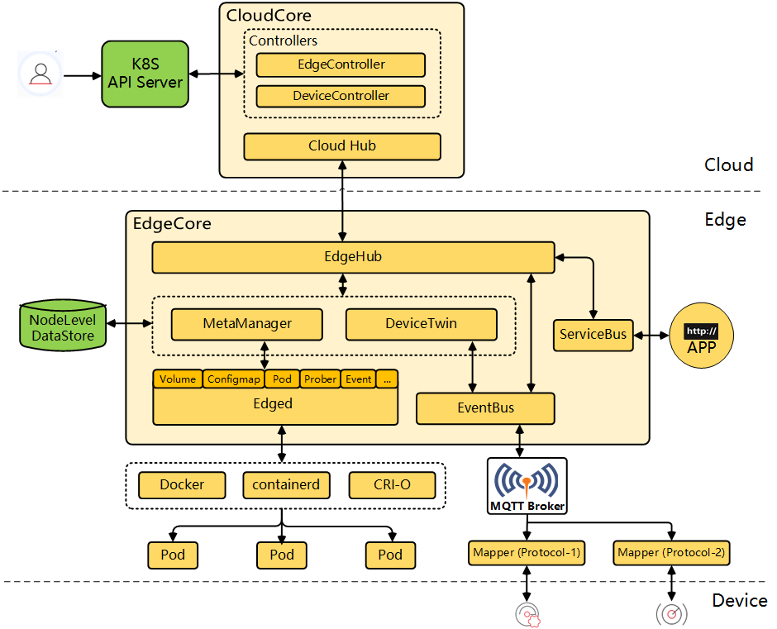
KubeEdge - Open source Public cloud Edge
KubeEdge is an open source system extending native containerized application orchestration and device management to hosts at the Edge.
It is built upon Kubernetes and provides core infrastructure support for networking, application deployment and metadata synchronization between cloud and edge.
Notes:
https://kubeedge.io/en/docs/kubeedge/

Slide 36
KubeEdge Components
KubeEdge is composed of these components:
Edged: an agent that runs on edge nodes and manages containerized applications.
EdgeHub: a web socket client responsible for interacting with Cloud Service for edge computing (like Edge Controller as in the KubeEdge Architecture). This includes syncing cloud-side resource updates to the edge and reporting edge-side host and device status changes to the cloud.
CloudHub: a web socket server responsible for watching changes at the cloud side, caching and sending messages to EdgeHub.
EdgeController: an extended kubernetes controller which manages edge nodes and pods metadata so that the data can be targeted to a specific edge node.
EventBus: an MQTT client to interact with MQTT servers (mosquitto), offering publish and subscribe capabilities to other components.
DeviceTwin: responsible for storing device status and syncing device status to the cloud. It also provides query interfaces for applications.
MetaManager: the message processor between edged and edgehub. It is also responsible for storing/retrieving metadata to/from a lightweight database (SQLite).

Slide 37
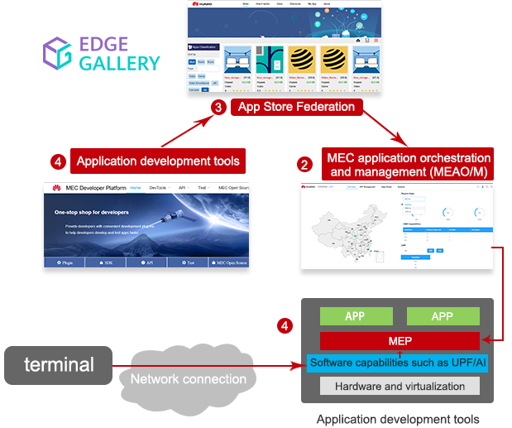
EdgeGallery: Open source Telco Edge
EdgeGallery is open source MEC based edge platform for Telcos.
It deliver a Edge PaaS system where application developer and integrator, develop, deploy and do life cycle management.
Details will be covered in future sessions

Slide 38
Exercise
Go through previous Cloud hands on video and do below exercise based on today's understanding:
On GCP create VM instance
Deploy and run applications.

Slide 39
Thanks

Slide 40
Why does edge computing matter?
Edge computing is the ability to process and store data faster, enabling for more efficient real-time applications that are critical to companies. Before edge computing, a smartphone scanning a person’s face for facial recognition would need to run the facial recognition algorithm through a cloud-based service, which would take a lot of time to process. With an edge computing model, the algorithm could run locally on an edge server or gateway, or even on the smartphone itself, given the increasing power of smartphones. Applications such as virtual and augmented reality, self-driving cars, smart cities and even building-automation systems require fast processing and response.
When IoT devices have poor connectivity.
Not efficient for IoT devices to be in constant touch with the central cloud.
The latency factor reduces latency because data doesn’t have to traverse over a network to a central cloud for processing.
Where latencies are untenable like manufacturing or financial services.
As soon as data is produced, it doesn’t need to send over a network; instead, it compiles the data and sends daily reports to the cloud for long term storage, i.e., reduces the data traversing.
The buildout of the next-generation 5G cellular networks by telecommunication companies.
Direct access to gateway into the telecom provider’s network, which connects to a public IaaS cloud provider.

Slide 41
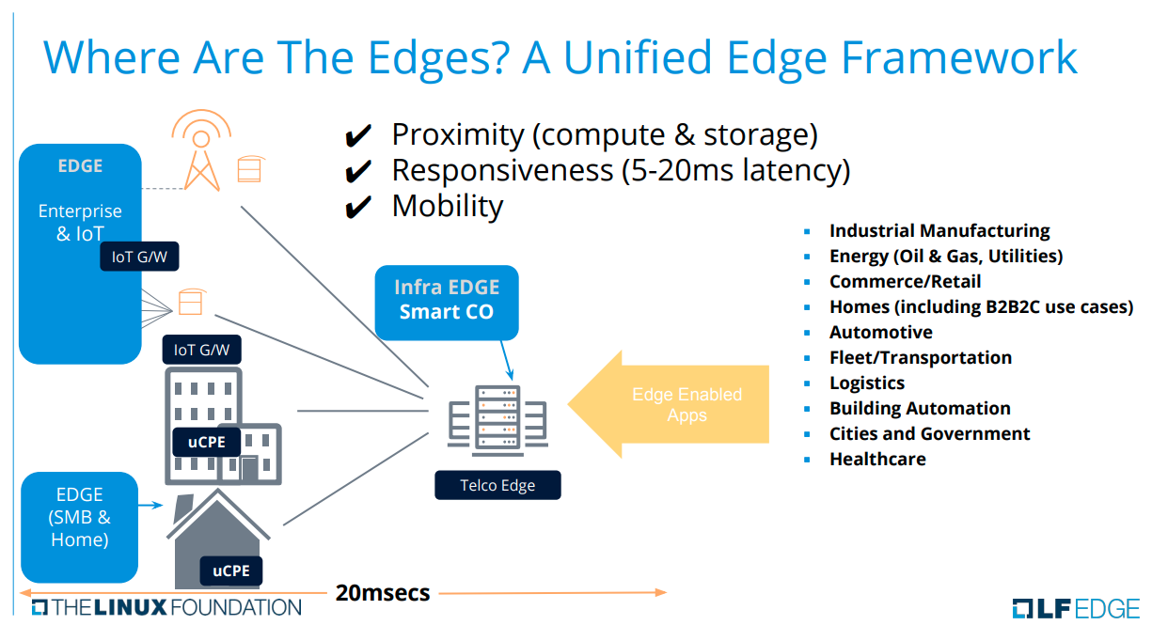

Slide 42
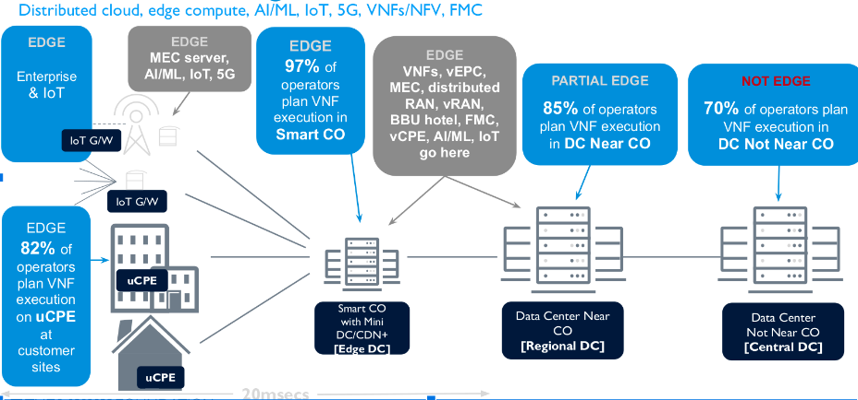
Where are Edges ?

Slide 43
Use Cases where Edge Computing becomes critical
Having low latency, e.g., Closed-loop interaction between machine insights.
For real-time analytics, access to temporal data.
Low connectivity, e.g., Remote Location.
The high cost of transferring data to the cloud.
Bandwidth.
Cybersecurity constraints.
Compliance and Regulation.
The immediacy of Analysis, e.g., To check machine performance.
Predictive Maintenance.
Energy Efficiency Management.
Flexible Device Replacement.
Notes:
https://www.xenonstack.com/blog/edge-computing/

Slide 44
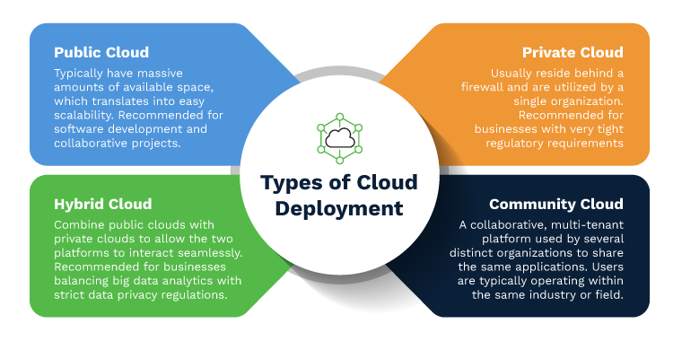
Deployment Models of Cloud Computing
Due to different need and limitations of users, Cloud provider provide cloud services with different way of deployment.
There are four main deployment models, each of which has its characteristics.
Public Cloud: Public Clouds can be used by the public on a commercial basis but owned by a cloud service provider.
Private Cloud: Private Clouds are deployed, maintained, and operated solely for specific organizations.
Community Cloud: Community Cloud infrastructures allow a cloud to be shared among several organizations with shared interests and similar requirements.
Hybrid Cloud: Hybrid clouds combine public and private clouds, bound together by technology that allows data and applications to be shared between them

Slide 45
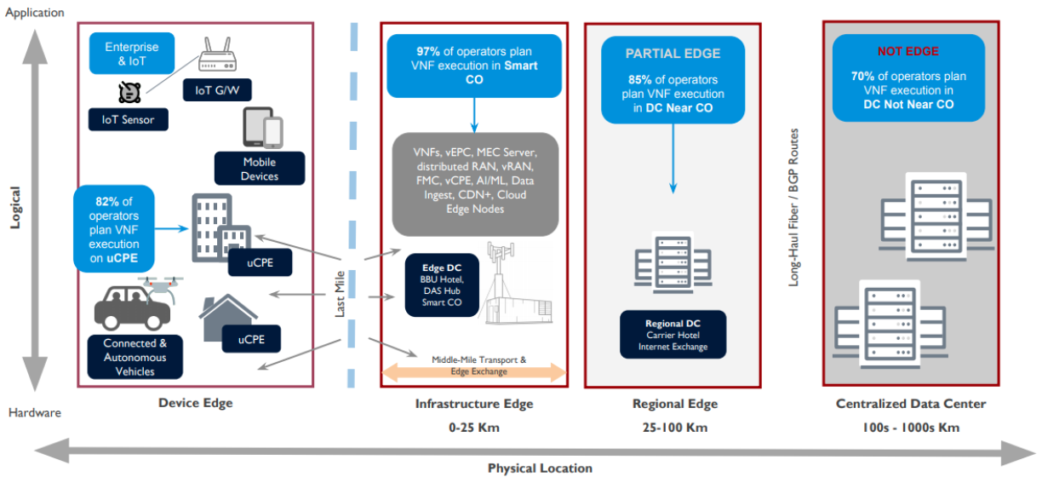
Different types of Edges - Continue

